Slide 1

Chapter One:
Introduction to Operating System (OS)
Wollo University, KIoT
Dept of IS

Slide 2
01
Overview Operating System(OS)
Contents
02
Key functions of OS
03
History of OS development
04
Types of OS
05
Basic Design issues of OS

Slide 3
What is an Operating System?
Computer System = Hardware + Software
Software = Application Software + System Software(OS)
An Operating System is a system software that acts as an intermediary/interface between a user of a computer and the computer hardware.
Operating system goals:
  Execute user programs and make solving user problems easier
  Make the computer system convenient to use.
  Use the computer hardware in an efficient manner

Slide 4
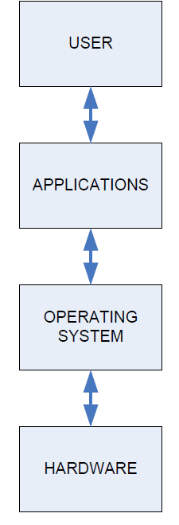
  Cont’d…
Accessing computer resources is divided into layers.
Each layer is isolated and only interacts directly with the layer below or above it.
Adding a New Hardware Device:
  No Changes Needed for Users/Applications: Because the operating system provides an abstraction layer, applications can utilize new hardware transparently without requiring source code modifications.
  Operating System Updates (Device Drivers): Changes are required within the operating system environment specifically, you must install the appropriate device driver that enables the OS to communicate with and control the new hardware.

Slide 5
Cont’d…
Installing a New Software Application:
  There is no need to make any physical changes or upgrades to your computer hardware.
  You must ensure that the application is fully supported by your current operating system.
  The user will need to learn how to navigate and use the new application.
Changing the Operating System:
  Upgrading or changing the OS requires verifying that both your hardware components (drivers, architecture) and software applications will be compatible with the new operating system.

Slide 6
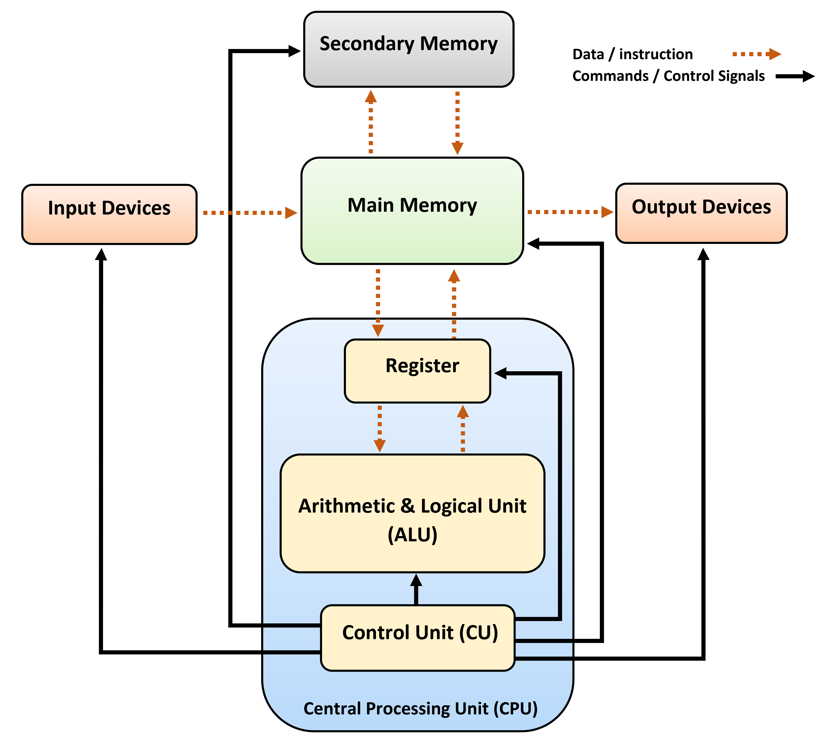
Computer Architecture

Slide 7
CPU – Central Processing Unit
This is the brain of your computer.
It performs all of the calculations.
In order to do its job, the CPU needs commands to perform, and data to work with.
The instructions and data travel to and from the CPU on the system bus.
The operating system provides rules for how that information gets back and forth, and how it will be used by the CPU.

Slide 8
RAM – Random Access Memory
This is like a desk, or a workspace, where your computer temporarily stores all of the information (data) and instructions (software or program code) that it is currently using.
  Each RAM chip contains millions of address spaces.
  Each address space is the same size, and has its own unique identifying number (address).
  The operating system provides the rules for using these memory spaces, and controls storage and retrieval of information from RAM.
  Device drivers for RAM chips are included with the operating system.

Slide 9
Cont’d…
Questions: If the operating system manages RAM, how does the computer access RAM to load the operating system in the first place?

Slide 10
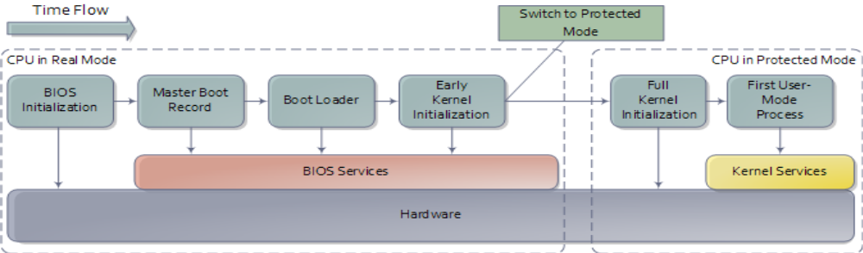
Starting an Operating System(Booting)
Power On Switch sends electricity to the motherboard on a wire called the Voltage Good line.
If the power supply is good, then the BIOS (Basic Input/Output System) chip takes over.
In Real Mode, CPU is only capable of using approximately 1 MB of memory built into the motherboard.
The BIOS will do a Power-On Self Test (POST) to make sure that all hardware are working.
BIOS will then look for a small sector at the very beginning of your primary hard disk called Master Boot Record (MBR).
The MBR contains a list, or map, of all of the partitions on your computer‘s hard disk (or disks).
After the MBR is found the Bootstrap Loader follows basic instructions for starting up the rest of the computer, including the operating system.
In Early Kernel Initialization stage, a smaller core of the Kernel is activated.
This core includes the device drivers needed to use computer‘s RAM chips.

Slide 11
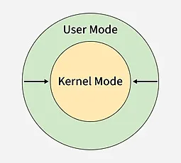
Operating System Mode
User mode and kernel mode are two key states in an operating system.
User mode runs regular applications with limited access to system resources, while kernel mode runs the core OS with full control over hardware.
This separation ensures security, stability, and efficient resource management.

Slide 12
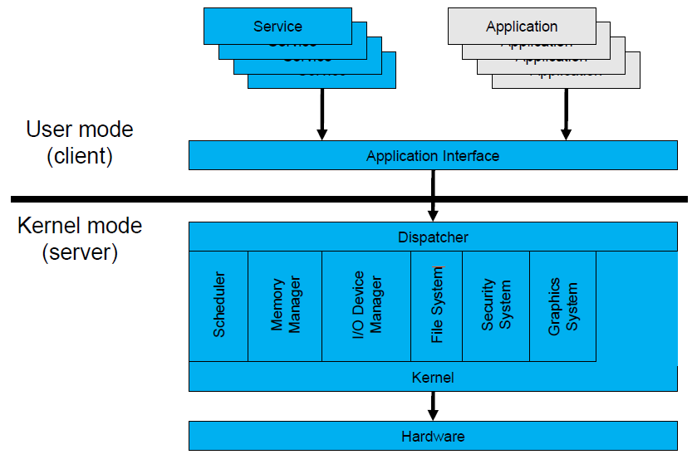
User Mode
User Mode is a restricted environment where application programs run.
When a program starts, the OS creates a separate process and assigns it its own memory space.
Programs in user mode can’t access hardware or kernel memory directly.
They must request access through system calls to the kernel.

Slide 13
User mode(Cont’d…)
Key Features of User Mode
  Each process runs in its own memory space.
  Only accessible through kernel services.
  Errors or crashes don’t affect the whole system.
Advantages:
  Easier debugging, crash containment, strict process isolation, controlled kernel access, enhanced system stability and reliability, and improved security.
Disadvantages:
  Performance and system call latency due to mode switching, restricted low-level capabilities, heavy reliance on the kernel, reduced real-time suitability, and limited developer control.

Slide 14
Kernel Mode
Kernel Mode is the privileged mode where the core part of the operating system, the kernel executes.
It has unrestricted access to all machine resources including CPU, memory, storage, and connected devices.
When a program running in user mode makes a request that requires hardware access, the system switches the CPU into kernel mode to perform the task.
After execution, control returns to user mode.

Slide 15
Kernel Mode (Cont’d…)
Key Features of Kernel Mode
  Can communicate with I/O devices, memory, and processor.
  Manages process scheduling, memory, and device drivers.
  Executes instructions that affect system-wide behavior.
Advantages:
  Full hardware access, efficient direct resource management (CPU, RAM, I/O), low overhead for system calls, and advanced scheduling control.
Disadvantages:
  High risk of total system crashes from bugs, difficult debugging, complex development requirements, and lack of process isolation (shared memory corruption risks).

Slide 16
Cont’d…
Kernel includes:-
  1. Scheduler: It allocates the Kernel’s processing time to various processes.
  2. Supervisor: It grants permission to use computer system resources to each process.
  3. Interrupt handler : It handles all requests from the various hardware devices which compete for kernel services.
  4. Memory manager : allocates space in memory for all users of kernel service.
kernel provides services for process management, file management, I/O management, memory management.
System calls are used to provide these type of services.

Slide 17
Summary
Summary of Differences
Feature | User Mode | Kernel Mode
Access Level | Restricted access | Full access to hardware
Privileges | Limited | Privileged
Memory Access | Only application memory | Entire system memory
Hardware Access | Indirect via system calls | Direct hardware interaction
Stability | Crashes affect only the process | Crashes can crash the whole OS
Use | Runs user applications | Runs OS core, device drivers

Slide 18
System call
User programs cannot directly access hardware or critical OS resources because it would make the system unstable and insecure.
To maintain safety, the operating system provides system calls controlled interfaces that allow user programs to request services from the kernel.
These calls act as a gateway between user mode and kernel mode.
System Calls are,
  A way for programs to interact with the operating system.
  Provide the services of the operating system to the user programs.
  Only entry points into the kernel are executed in kernel mode.

Slide 19
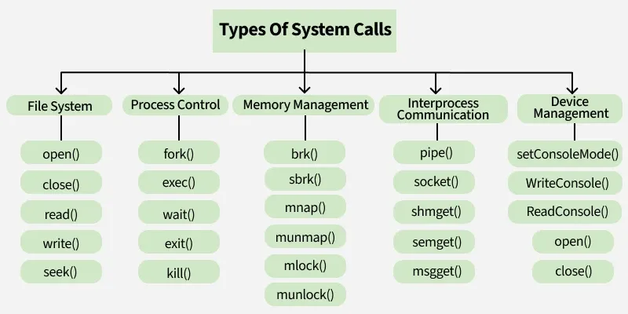
System call
Types of System Calls
  Services provided by an OS are typically related to any kind of operation that a user program can perform like creation, termination, forking, moving, communication, etc.
  Similar types of operations are grouped into one single system call category. System calls are classified into the following categories:

Slide 20
Functions of Operating System
An Operating System (OS) is software that acts as a bridge between the user and the computer hardware.
It provides an environment where users can execute programs efficiently and conveniently.
  Manages and controls all computer resources.
  Provides services and resources to user programs.
  Coordinates and monitors program execution to prevent errors.
  Offers a user interface (virtual machine) and hides software complexity.
  Supports multiple execution modes for programs.

Slide 21
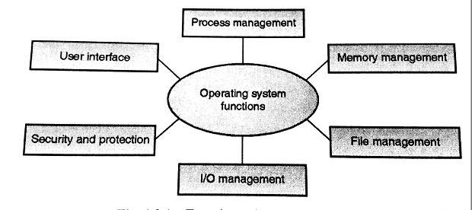
Functions of Operating System(Cont’d…)

Slide 22
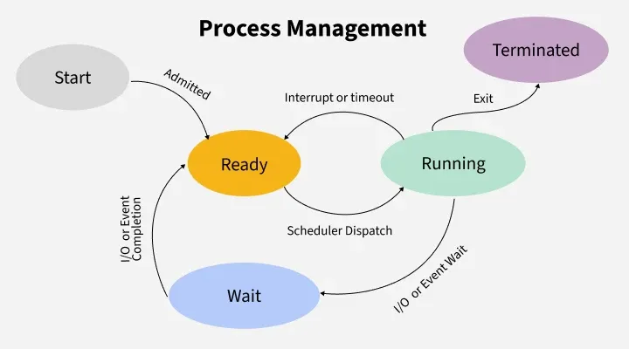
Process Management
Process management in operating system is about managing processes.
A process is a running program.
The life cycle of process is from the moment program start until it finishes.

Slide 23
Cont’d…
Core Functions in Process Management:
  Scheduling: Decides which process uses the CPU next (using algorithms like Round Robin or Priority Scheduling).
  Synchronization: Ensures orderly execution using locks, semaphores, or monitors to prevent race conditions.
  Deadlock Handling: Detects and prevents situations where processes wait forever for resources.
  Inter-Process Communication (IPC): Allows processes to exchange data via shared memory or message passing.

Slide 24
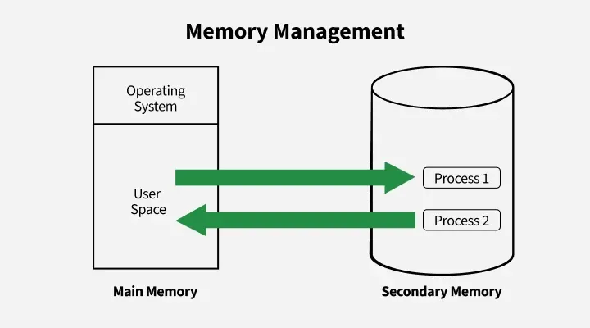
Memory management
Memory management in an operating system controls how data is stored and organized in main (primary) memory and secondary storage, ensuring programs get the memory they need and freeing it when no longer used.
Key Activities in Memory Management:
  Allocation & Deallocation
  Protection
  Fragmentation Handling
  Disk Management:
    Handles file storage, free space,
    disk scheduling, and backups.

Slide 25
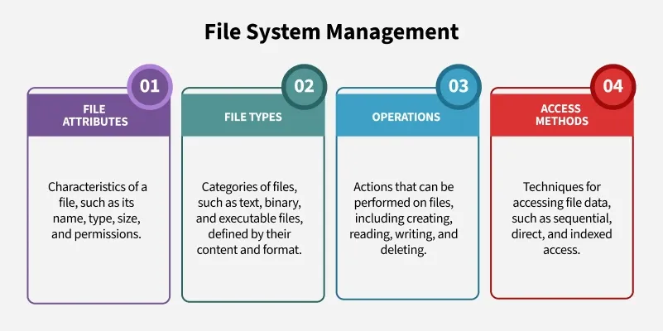
File Management
File management in an operating system organizes and controls how data is stored, named, and accessed on storage devices, making it easy for users to find and use their files.

Slide 26
Device Management or I/O Management
Device management in an operating system controls how the computer communicates with hardware devices like printers or disks, using drivers and techniques to ensure smooth and efficient operation.
Major components in Device Management:
  Device Drivers: Interface between hardware and OS.
  Buffering & Caching: Temporarily store data to match device speeds and improve performance.
  Spooling: Manages data waiting to be processed, particularly in devices like printers.
  The OS places print jobs in a spool (a temporary storage area), allowing the CPU to continue other tasks while the printer works through the queue.

Slide 27
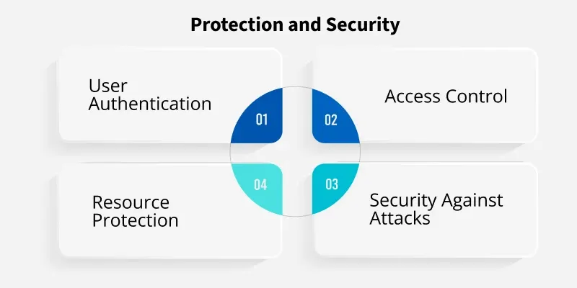
Security & Protection
Security mechanisms in an OS are designed to safeguard system resources from unauthorized access or misuse.
These mechanisms control which processes or users can access specific resources (such as memory, files, and CPU time).
It also ensures that only authorized users can perform specific actions.

Slide 28
User Interface Mechanism
A user interface (UI) controls how you enter data and instructions and how information is displayed on the screen.
There are two types of user interfaces
  Command Line Interface
  Graphical user Interface

Slide 29
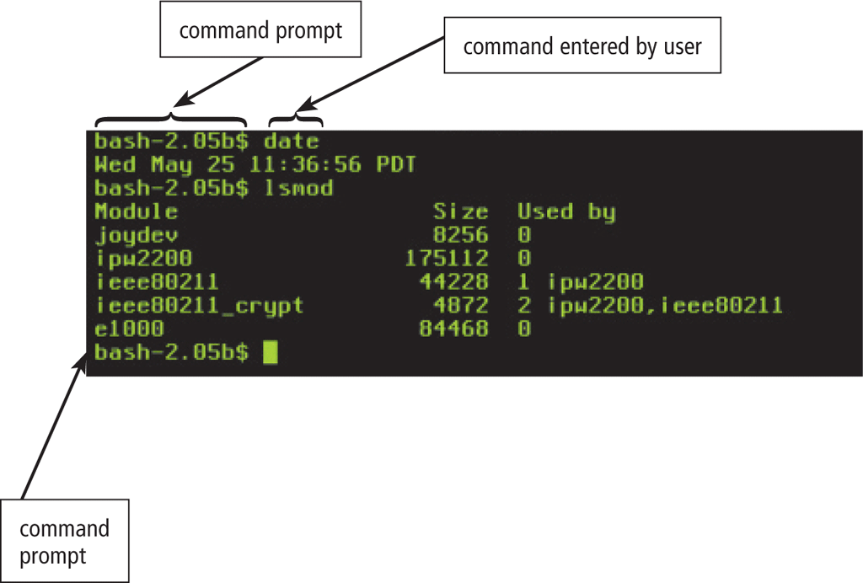
Cont’d…
In a command-line interface, a user types commands represented by short keywords or abbreviations or presses special keys on the keyboard to enter data and instructions

Slide 30
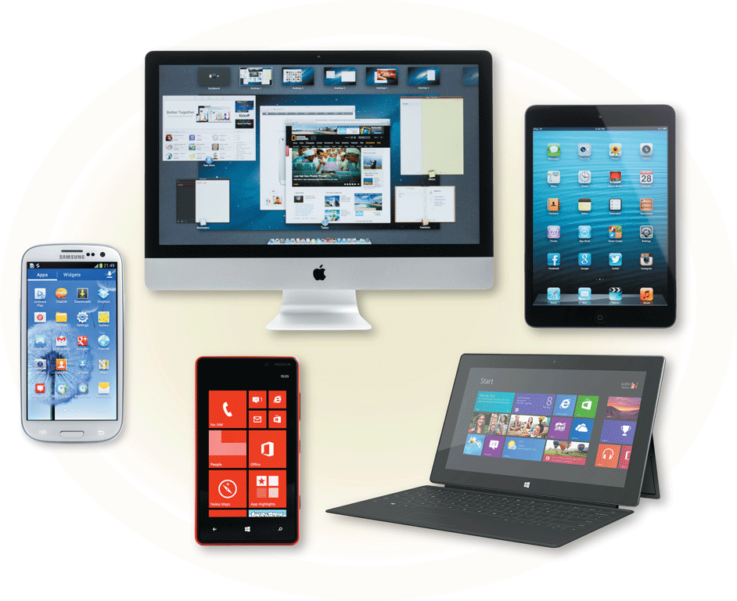
Cont’d…
With a graphical user interface (GUI), you interact with menus and visual images

Slide 31
History of Operating System
Generations of Operating Systems
1940s-1950s: Early Beginnings
  No Operating System: Computers operated without dedicated OS software.
  Programs were loaded manually and run one at a time.
  It used Punched cards.
  The first operating system was introduced in 1956.
  It was a batch processing system GM-NAA I/O (1956) that automated job handling.
1960s: Multiprogramming and Timesharing
  Introduction of multiprogramming to utilize CPU efficiently.
  Timesharing systems, like CTSS (1961) and Multics (1969), allowed multiple users to interact with a single system.

Slide 32
Cont’d…
1970s: Unix and Personal Computers
  Unix (1971) revolutionized OS design with simplicity, portability, and multitasking.
  Personal computers emerged, leading to simpler OSs like CP/M (1974) and PC-DOS (1981).
1980s: GUI and Networking
  Graphical User Interfaces (GUIs) gained popularity with systems like Apple Macintosh (1984) and Microsoft Windows (1985).
  Networking features, like TCP/IP in Unix, became essential.

Slide 33
Cont’d…
1990s: Linux and Advanced GUIs
  Linux (1991) introduced open-source development.
  Windows and Mac OS refined GUIs and gained widespread adoption.
2000s-Present: Mobility and Cloud
  Mobile OSs like iOS (2007) and Android (2008) dominate.
  Cloud-based and virtualization technologies reshape computing, with OSs like Windows Server and Linux driving innovation.

Slide 34
Cont’d…
AI Integration - (Ongoing)
  With the growth of time, Artificial intelligence came into picture.
  Operating system integrates features of AI technology like Siri, Google Assistant, and Alexa and became more powerful and efficient in many way.
  These AI features with operating system create a entire new feature like voice commands, predictive text, and personalized recommendations.

Slide 35
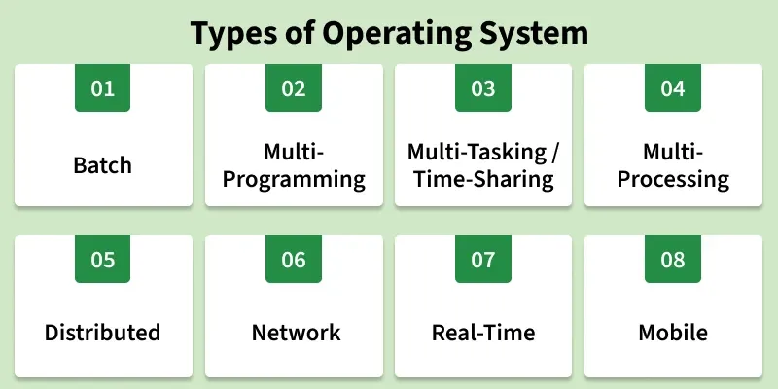
Types of Operating Systems
An operating system (OS) is software that manages computer hardware and software resources.
It acts as a bridge between users and the computer, ensuring smooth operation.
Different types of OS serve different needs; some handle one task at a time, while others manage multiple users or real-time processes.

Slide 36
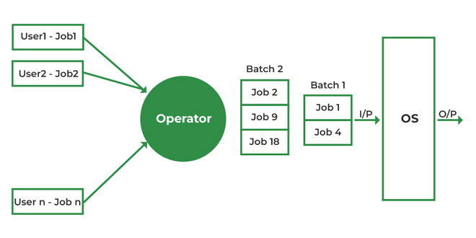
1. Batch Operating System
It is designed to handle large groups of similar jobs efficiently.
Each user prepares his job on an off-line device like punch cards and submits it to the computer operator.
It does not interact with the computer directly but instead processes jobs that are grouped by an operator.
These jobs are queued and executed one after the other, without user interaction during the process.

Slide 37
Cont’d…
Advantages:
  Minimal idle time,
  Efficient handling of repetitive tasks (e.g., payroll, billing), and
  Improved overall throughput.
Disadvantages:
  Inefficient CPU utilization during I/O waits,
  High response times due to sequential processing, and
  A lack of real-time user interaction.
Examples: Insurance claim processing, library book records, and stock market reports.

Slide 38
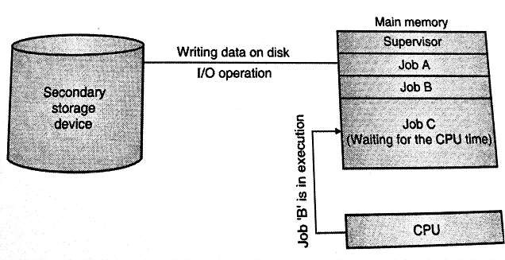
2. Multiprogramming Operating System
In a Multiprogramming Operating System, multiple programs run in memory at the same time.
The CPU switches between programs, utilizing its resources more effectively and improving overall system performance.
Multiprogramming operating systems use the mechanism of job scheduling and CPU scheduling.

Slide 39
Cont’d…
Advantages:
  Better CPU utilization via I/O switching,
  Improved throughput from concurrent job execution, and
  Efficient sharing of system resources.
Disadvantages:
  Complex design requiring advanced memory management and scheduling,
  Potential security vulnerabilities from shared memory, and
  Higher RAM requirements.
Examples: Banking systems, railway servers, and billing machines.

Slide 40
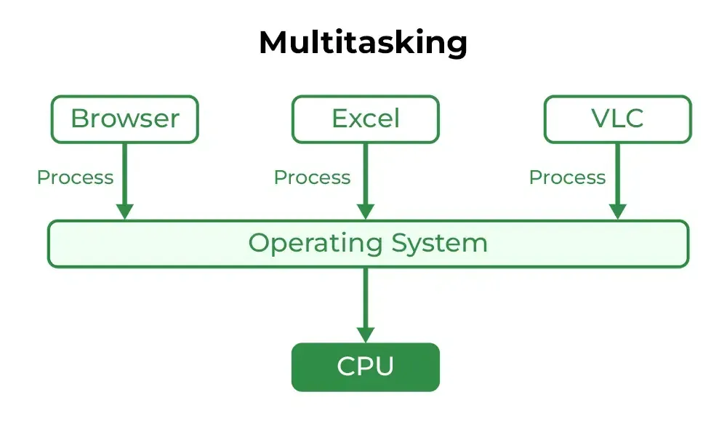
3. Multitasking/Time-Sharing Operating Systems
Multitasking OS is a type of multiprogramming system where each process runs in a round-robin manner.
Every task gets a fixed time slice called a quantum.
After the quantum ends, the OS switches to the next task, allowing multiple tasks whether from one user or many to run smoothly on a single system.

Slide 41
Cont’d…
Advantages:
  Equal CPU time distribution among tasks,
  Reduced software duplication through shared applications, and
  Low CPU idle time via efficient scheduling.
Disadvantages:
  Lower overall reliability (system failures impact all users),
  Security and privacy concerns from multi-user access, and
  Potential data-sharing communication conflicts.
Examples: IBM VM/CMS, TSO (Time Sharing Option), Windows Terminal Services.

Slide 42
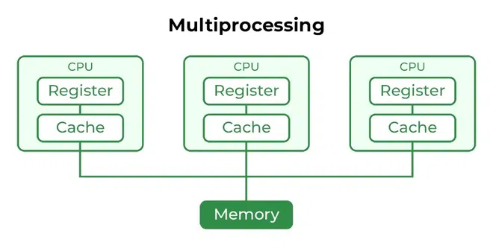
4. Multiprocessor operating systems
Multi-Processing OS is a type of Operating System in which more than one CPU is used for the execution of processes.
Multiprocessor operating systems are also known as parallel OS or tightly coupled OS.
It betters the throughput of the System.

Slide 43
Cont’d…
Advantages:
  Faster processing via simultaneous multi-CPU execution,
  High reliability (fault tolerance if a processor fails), and
  Strong support for computation-intensive tasks.
Disadvantages:
  High hardware and system costs,
  Complex OS design required for communication and
  Task distribution, and potential resource waste from poor task allocation.
Examples: UNIX, Linux (Ubuntu, Red Hat, Debian), macOS.

Slide 44
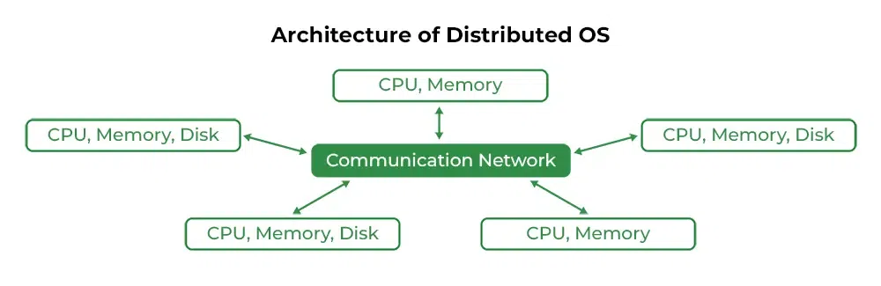
5. Distributed Operating System
Distributed operating systems connects multiple independent computers through a shared communication network.
Each system has its own CPU and memory but works together as a single unit.
The main benefit is remote access, allowing users to use files and software stored on other connected systems.

Slide 45
Cont’d…
Advantages:
  Independent systems with failure isolation (one machine failing doesn't affect others),
  Easy scalability by adding new nodes, and
  Faster task handling across multiple machines.
Disadvantages:
  Heavy network dependency (communication stops if the network fails),
  Lack of standard models or languages, and
  High cost with software complexity.

Slide 46
Cont’d…
Issues / Challenges:
  Data transfer delays across nodes cause inconsistent data views and make tracking the chronological order of events difficult.
  Critical control functions (scheduling, resource allocation, and deadlock detection) must be managed across multiple nodes to achieve speedup and fault tolerance.
  Messages traveling over public networks can be intercepted, tampered with, or faked by intruders to bypass authentication and masquerade as users.
Examples: LOCUS, MICROS, Amoeba.

Slide 47
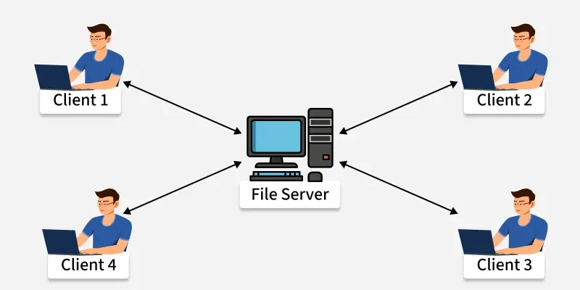
6. Network Operating System
A Network Operating System (NOS) runs on a server and manages data, users, security, applications, and other network functions.
It allows shared access to files, printers, and resources within a small private network.
Users can see the configuration and connections of other users, which is why these systems are considered loosely coupled systems.

Slide 48
Cont’d…
Advantages:
  Centralized and reliable resource management via stable servers, easy hardware and technology upgrades, and
  Remote accessibility across locations and devices.
Disadvantages:
  High setup and maintenance costs for servers, heavy operational dependency on the central server, and
  A continuous need for regular maintenance and technical updates.
Examples: Microsoft Windows Server 2003, UNIX, Linux, Mac OS X.

Slide 49
7. Real-Time Operating System
The time interval required to process and respond to inputs is very small.
Real-time systems are used when there are time requirements that are very strict like missile systems, air traffic control systems, robots, etc.
Types of Real-Time Operating Systems
  Hard Real-Time Operating System:
    Used where strict timing is essential and any delay is unacceptable, such as airbags or automatic parachutes.
  Soft Real-Time Operating System:
    Used where timing is important but minor delays are acceptable.
    They are commonly used in multimedia applications, gaming, video streaming, and other interactive tasks.

Slide 50
Cont’d…
Advantages:
  Maximum resource utilization,
  Error-free operation, and
  Well-managed memory allocation.
Disadvantages:
  Limited concurrent tasks,
  Highly complex algorithms, and
  Poor suitability for frequent task switching or thread priority adjustments.
Examples: Scientific experiments, medical imaging systems, and robots.

Slide 51
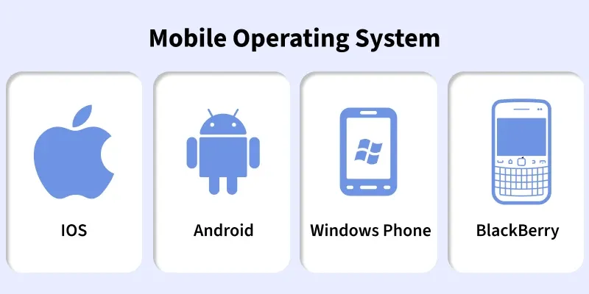
8. Mobile Operating System
Mobile operating systems are designed specifically for mobile devices such as smartphones and tablets.
Examples of such operating systems are Android and iOS.
These operating systems manage the hardware and software resources of the device, providing a platform for running applications and ensuring a seamless user experience.

Slide 52
Cont’d…
Advantages:
  User-friendly, intuitive interfaces accessible to everyone,
  Extensive app ecosystems for deep customization, and
  Robust connectivity options.
Disadvantages:
  Battery life constraints under heavy usage,
  Security risks like malware and phishing, and
  Fragmentation issues (especially in Android) that complicate app compatibility.
Examples: Android, iOS, Blackberry.

Slide 53
Desktop Class Operating Systems
Designed primarily for personal computers, workstations, and laptops, focusing on single-user or multi-user multitasking with rich graphical user interfaces (GUIs), file management, and broad peripheral support.
Examples:
  Microsoft Windows: The most widely used desktop OS globally, known for massive software and gaming compatibility.
  macOS: Apple's proprietary OS designed exclusively for Mac computers, praised for its sleek UI and hardware integration.
  Linux Desktop (Ubuntu, Fedora, Mint): An open-source operating system favored by developers, power users, and privacy advocates.

Slide 54
MS-DOS (Microsoft Disk Operating System)
MS-DOS was the Microsoft-marketed version of the first operating system (OS) to be widely installed on personal computers (PCs).
Single User Single Tasking OS.
It had no built-in support for networking, and users had to manually install drivers any time they added a new hardware component to their PC.
DOS supports only 16-bit programs.
Command line user interface.
So, why is DOS still in use?
  Two reasons are its size and simplicity.
  It does not require much memory or storage space for the system, and it docs not require a powerful computer.

Slide 55

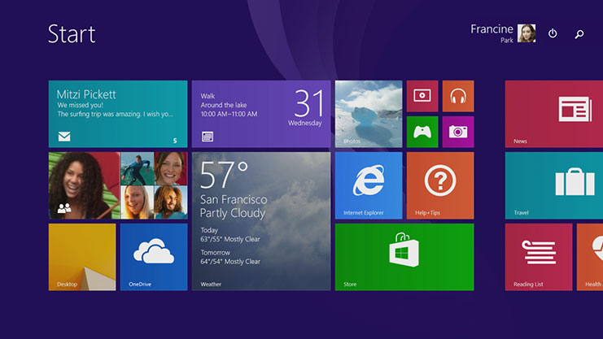
Microsoft Windows
The graphical Microsoft operating system designed for Intel-platform desktop and notebook computers.
Best known, greatest selection of applications available.
Current editions include Windows 7, 8, 8.1,10 and 11.

Slide 56
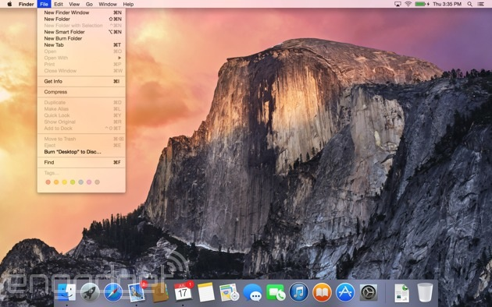
Mac OS
User-friendly, runs on Mac hardware.
Many applications available.
Current editions include: Sierra, High Sierra, Mojave, Catalina & Big Sur—Version XI(Released in Nov 2020)

Slide 57

Linux
Linux: An open-source, cross-platform operating system that runs on desktops, notebooks, tablets, and smartphones.
  The name Linux is a combination Linus (the first name of the first developer) and UNIX (another operating system).
Users are free to modify the code, improve it, and redistribute it,
Developers are not allowed to charge money for the Linux kernel itself (the main part of the operating system), but they can charge money for distributions (distros for short).

Slide 58
Server Operating Systems
Windows Server
  Familiar GUI interface for those experienced with Windows
UNIX
  Very mature server capabilities, time-tested, large user community, stable
Linux
  Free, customizable, many free services and utilities available

Slide 59
Tablet and Phone Operating Systems
  Operating systems specifically optimized for mobile hardware, prioritizing battery efficiency, touch interfaces, and wireless mobility.
  Key Features:
    Multi-touch and gesture-based user interfaces.
    Aggressive power management for extended battery life.
    Strict application sandboxing and permission controls.
    Native integration with mobile sensors (GPS, cameras, accelerometers).
  Major Examples: Android and iOS.

Slide 60
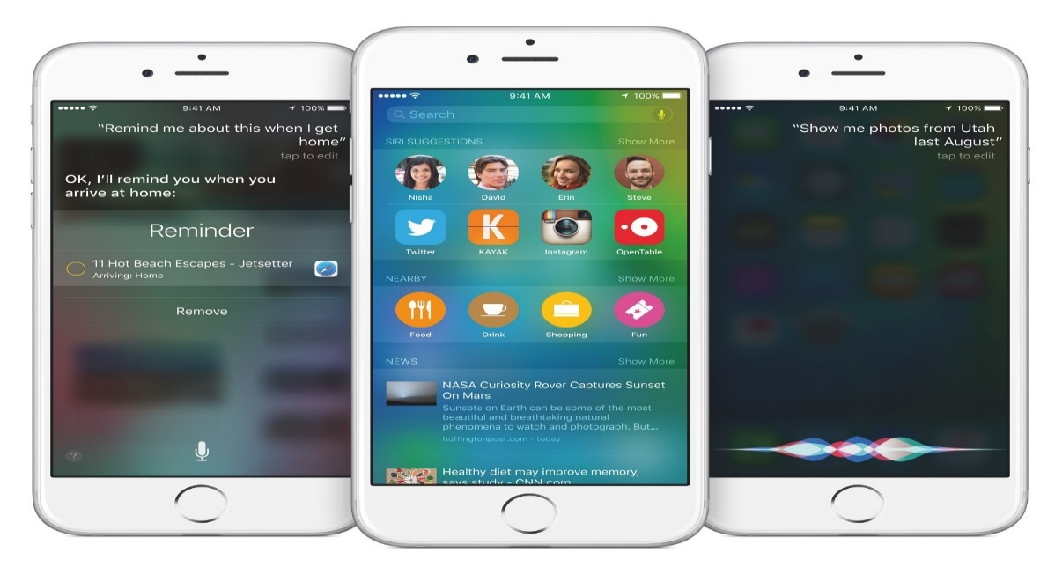
iOS on the iPhone and iPad
The mobile operating system created and developed exclusively by Apple for its phones (iPhone) and tablets (iPad).
Core Architecture:
  Built on a Unix-like foundation (Darwin), emphasizing hardware-software integration, rigorous application sandboxing, and strict user privacy controls.
  Apple continues to release major annual updates, with recent milestones including iOS 17 (2023), iOS 18 (2024), iOS 26 (2025), and iOS 27 (2026).

Slide 61

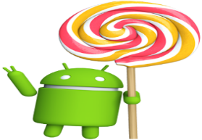

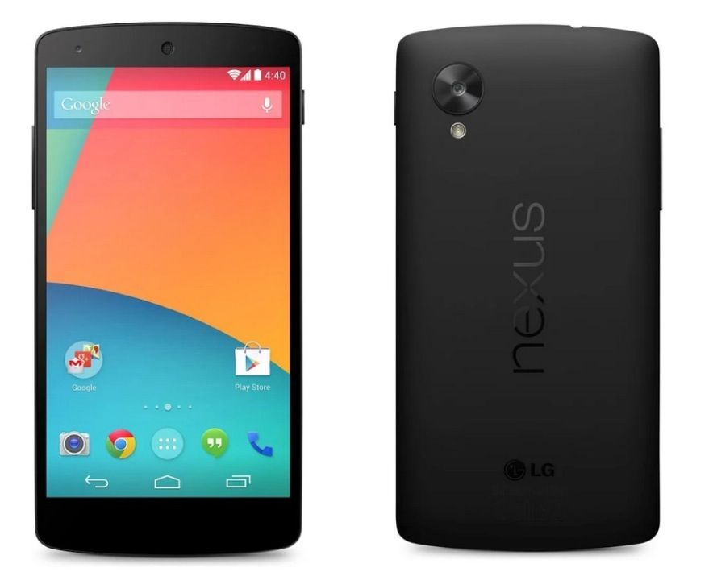
Android
Android, a popular OS for smartphones and tablets, is based on Linux Kernel.
  Developed by Google
Current versions include:
  Android 8 Oreo
  Android 9 Pie
  Android 10
  Android 11 (released on Sep, 2020)

Slide 62
Basic Design Issues of OS
When designing the OS, we must consider the following issues:
    Efficiency
    Robustness
    Portability
    Security
    Compatibility
    Flexibility

Slide 63
Efficiency
Efficiency is the optimization of resource utilization to maximize overall system performance and minimize overhead.
Core Objectives:
  Ensuring that hardware components operate at high utilization rates without leaving valuable CPU cycles or memory space idle.
  Minimizing the time and energy spent by the operating system on internal administrative tasks rather than executing user programs.
Key Areas of Focus:
    CPU Scheduling
    Memory Management
    I/O Optimization:

Slide 64
Robustness
Robustness is the ability of a computer system to cope with errors during execution and cope with erroneous input.
Common hardware failures in distributed environments include the failure of a link, the failure of a site, and the loss of a message.
To ensure a system is robust, it must detect any of these failures, reconfigure the system so that computation can continue, and recover when a site or link is repaired.
Building robust systems that encompass every point of possible failure is difficult because of the vast quantity of possible inputs and input combinations.

Slide 65
Portability
Portability is the ability of an operating system to be transferred and executed across different hardware platforms, architectures and device types with minimal or no modification to its core codebase.
Operating systems are written predominantly in portable high-level languages (like C) rather than machine-specific assembly code.
The core challenge is balancing complete platform independence with hardware-specific performance optimization.

Slide 66
Security
Security is the protection of system resources, user data, memory spaces, and communication channels from unauthorized access.
Core Objectives:
  Ensuring that sensitive data and private user files can only be accessed by authorized entities.
  Preventing unauthorized modification, corruption, or deletion of system files, code, and user data.
  Ensuring that system resources and services remain accessible to legitimate users without being disrupted by denial-of-service (DoS) attacks or system failures.

Slide 67
Compatibility
Compatibility is the capacity for two systems to work together seamlessly without having to be altered to do so.
Compatible software applications are designed to use the same standardized data formats for smooth data exchange.
These challenges typically arise when users employ the same category of software for a task (such as different word processors) that cannot communicate or share files with each other.
Compatibility problems generally stem from differences in software versions or from applications being developed by different companies.

Slide 68
Flexibility
Flexibility is the ability of an operating system to easily adapt:-
  To change requirements,
  New hardware technologies, or
  System modifications without requiring a complete system redesign or rewrite.

Slide 69


